Slide 1


TheBi$$0N7 Conept With help of the locals close to the Carpathiens we try to keep the variety of the fauna in this area constant. Members: Saahiti Prayaga, Antonia Mateescu, Vlad Niculescu, Luca Näf, Jonas Heim, Julian Colle, Johan Böni Challenge: Bisons Tokens …

Slide 2
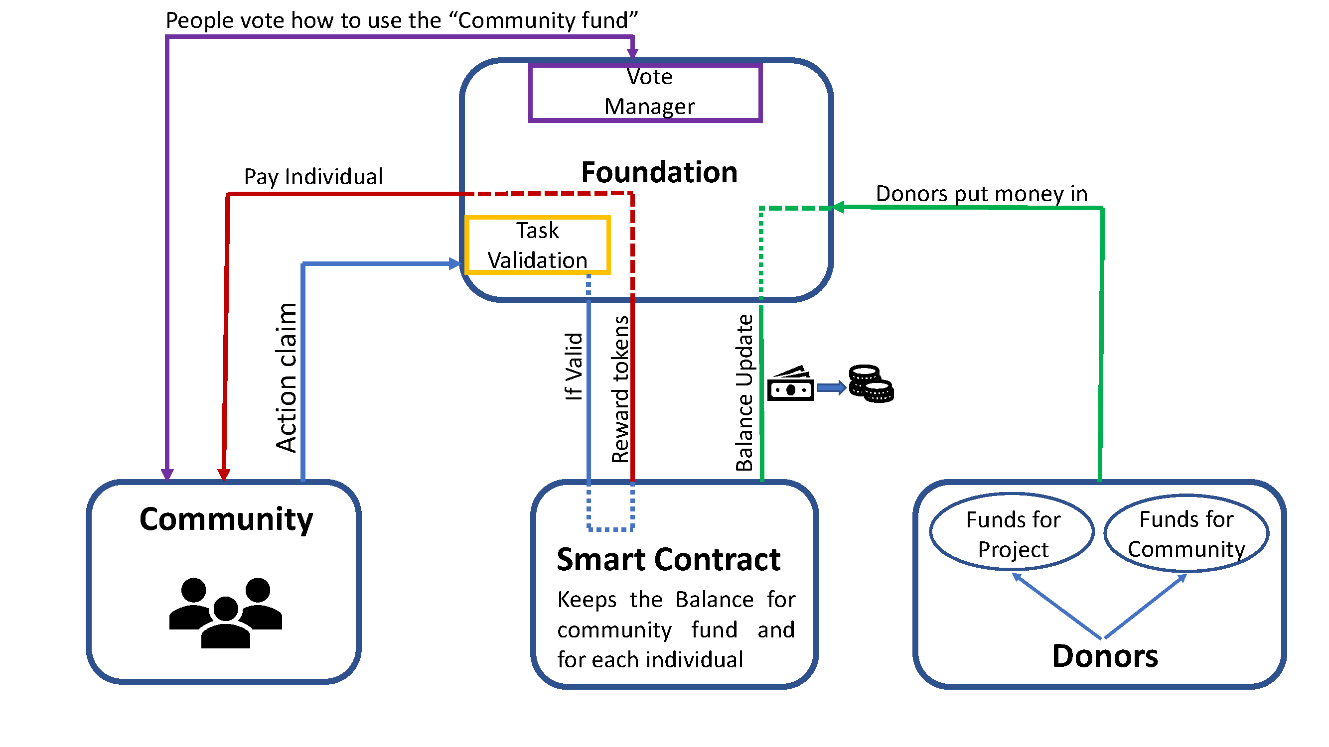
Our platform Green planet is revolutionizing the maintenance of our fauna in the wilderness. Through activities of the locals they get rewarded with an amount of Green tokens and Community tokens.

Slide 3
Tokens are created 1:1 to the donated project money 1 Leu (local currency) = 1 green token + 1 community token
Green Tokens
Community Tokens
Personal Reward
Possible to buy living needs
Community reward
Are used to participated in the bonus voting system
Increases your weight of your vote
Cannot be sold or transferred

Slide 4
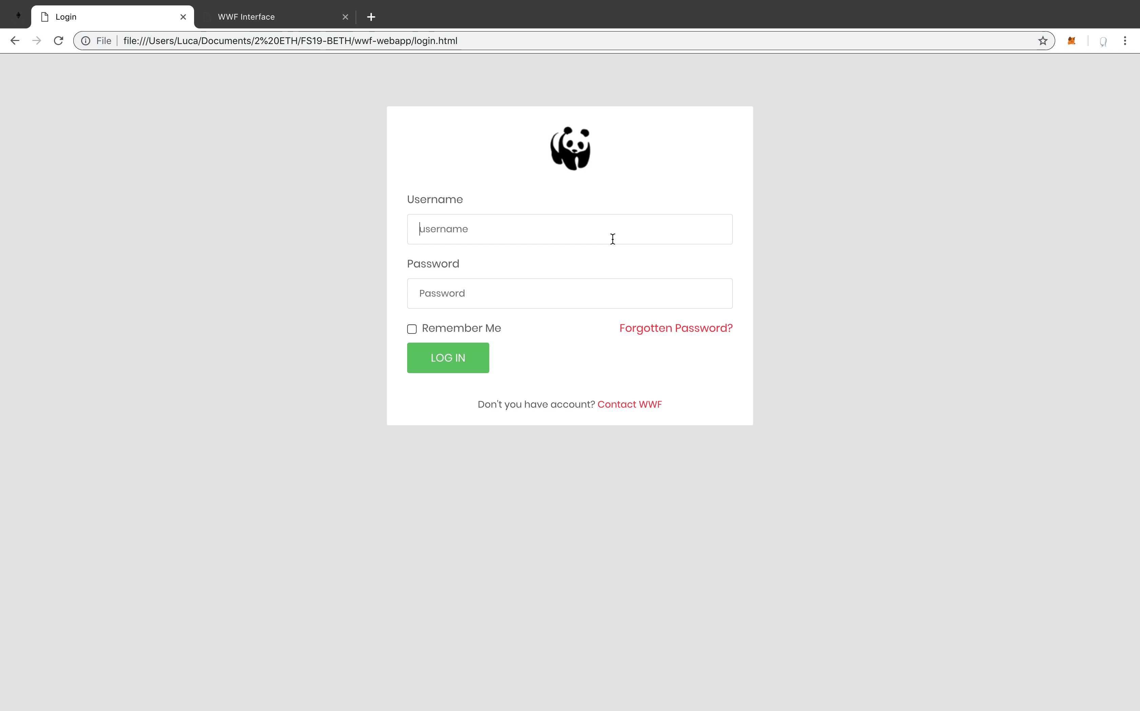
Demo of our website Green Planet

Slide 5
Further work
Chances
fully integrate the voting system into blockchain
automated data validation
Website is scalable to other projects
Multiple validation of activities by randomly picked people from other projects as an activity
by developing technology even further, new/smarter sensors can emerge (drones & heat cameras)

